Slide 1
ToDo
Comparing crash detection ability of AFL++ normal mode and that of persistent mode
On a program with known crashes
Comparing fuzzing speed of AFL++ with address sanitizer to that without the sanitizer
Implementing automated global variable initialization for AFL++ persistent mode

Slide 2
Inefficiency on Fuzzer Implementations
Redundant initialization of program states across inputs
Mitigated by Deferred Initialization (DI)
Time-consuming file read operation (from an input file or stdin) for each test case
Mitigated by Shared memory Test Cases (STC)
Overhead of fork() system call for each input
Mitigated by Persistent Mode (PM)
All the DI, STC, and PM are manually configured

Slide 3
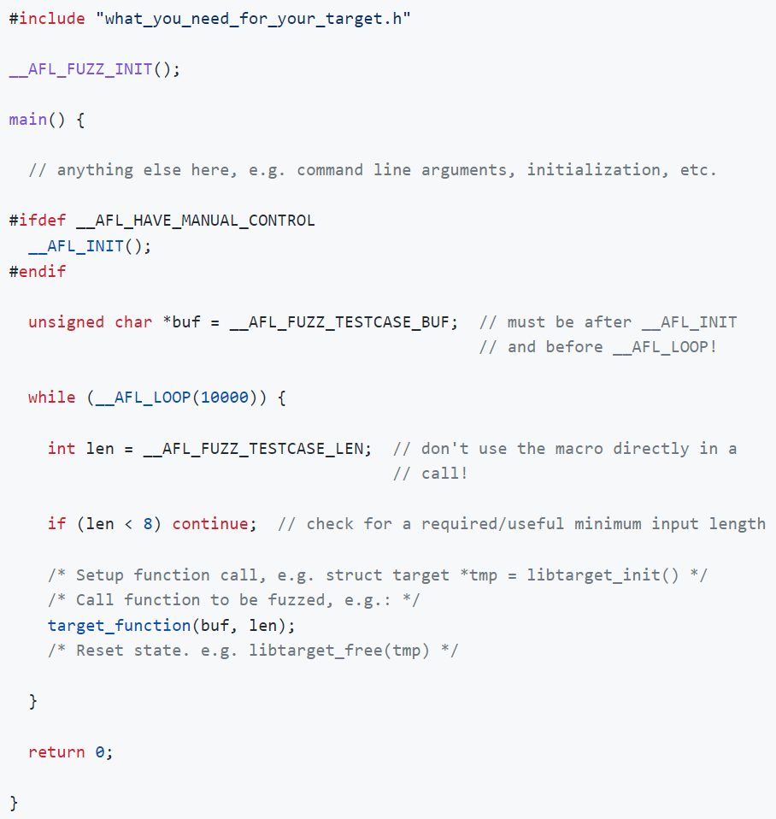
Deferred Initialization, Shared Memory TC, and Persistent Mode in AFL++
For DI
Manually inserted after the redundant initializations such as command line argument processing, variable initialization
For STC
Manually inserted after the file read operations of input file processing
For PM
Manually inserted to notify actual fuzzing target code
Fuzzing target code
An example fuzz driver

Slide 4
Comparing Fuzzing Performance with Each Optimization
Four configurations with manually analyzed and modified code
Normal
PM
DI
DI+STC
DI+STC+PM

Slide 5
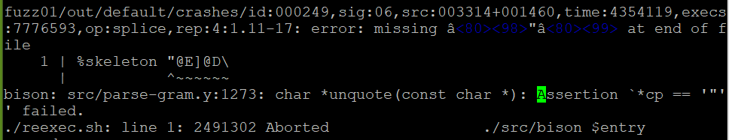
Target Program (1/2)
bison 3.7
Taking a context-free grammar and generating a parser for the grammar
The version that Ahcheong found an assertion failure using AFL++
The case where a string in grammar def. has unmatched quotation mark (e.g., “aadbdd)
input file name
the location of
the violated assertion
An example crash due to the known assertion failure

Slide 6
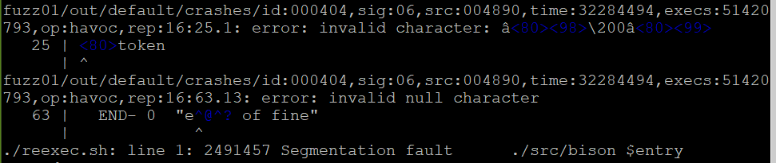
Target Program (2/2)
bison 3.7
Many assert statements inserted
Frequent crashes due to invalid symbols and keywords caused by mutation
An example crash other than assertion failure in bison

Slide 7
AFL++ Configuration
AFL++ 4.00c LLVM-PCGUARD mode (default mode)
Fuzz driver for
Normal mode: compile bison using afl-clang-fast with no modification
PM: wrap whole main function with the __AFL_LOOP as the fuzzing target; compile using afl-clang-fast; no state re-initialization
DI, DI+STC, DI+STC+PM (not yet)
Seed inputs Ahcheong provides
No sanitizer
12 hours time-limit

Slide 8
Results (1/2)
No speed-up when using PM wrapping main
 | exec/sec | bitmap_cvg | stability | saved crashes
Normal | 1499.67 | 28.89% | 100.00% | 412
PM | 1482.73 | 29.50% | 28.61% | 570

Slide 9
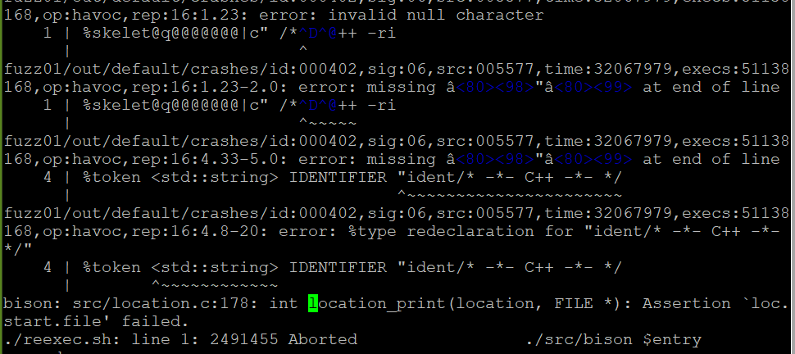
Results (2/2)
Normal finds 16 inputs inducing the known assertion failure and 2 inputs inducing another assertion failure among 412 saved crashes
while PM finds an input inducing the known assertion failure
the “another” assertion failure due to invalid FILE start location
the “another” assertion failure that normal finds

Slide 10
Next ToDo
Compare Normal to DI and DI+STC
where DI and DI+STC are manually configured

